Slide 1
Role of Belgium partners in BiH
Notes:
Good afternoom, my name is Belinda Drieghe and I am a member of the Odisee university college.
Unfortunately I have not passed along the entire project. I have participated in 2014 in the practical training in Sint-Niklaas and only since January 2016 I am an offical member of the CCNURCA project. Before me an formal collega have participated on every meeting in name of the Odisee university college.
I’am goinig to describe briefly the role of the odisee university in the CCNRCA project.

Slide 2
The University college of Odisee was, as lead partner of the project, together with the University of East Sarajevo, responsible for the project management.
During the kick off meeting in Gent, the purpose of the project and the work packages were clarified.
As lead partner our competence based approach of nursing and our quality management system was presented.
Notes:
Kick off meeting (april 2014)
The purpose of the project was to reform the nursing curricula of the Western Balkan universities in line with the Bologna declaration.
Aims of the project was to introduce better contact with the work field, more clinical practice, more competence based trainings focusing on learning outcomes).

Slide 3
Notes:
Odisee, university college was also responsible for the report about the comparative analysis between the EU and WB in nursing education. In order to make this report, Western Balkan partners had to pass on the necessary information.

Slide 4
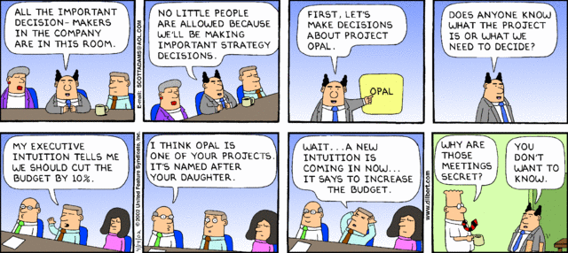
During every meeting the deadlines and responsibilities were mentioned.
Also future activities and obligations of the WB partners were discussed and given.
Notes:
Every EU partner was responsible for a few partners of the Project. Belgium became the mentor and coach of the participating universities of Bosnia Herzegovina.

Slide 5
During the training in Zenica about setting up learning outcomes for a new curriculum, workshops about the developping of a new curriculum were organised.
The participants of the WB Universities were divided into small work group of 5 to 7 persons.
Every group was coached by a mentor of one of the EU-partners. They prepared templates and a set of questions which helped the WB universities in their discussion.
Notes:
The mentors of the EU-countries prepared templates and a set of questions which helped the participants of the universities of BiH in their discussion.

Slide 6
Guiding questions
Content of theoretical courses?
Clinical learning/skill training?
How to translate outputs in learning outcomes?
(Re)Organization of internship?
Ratio practical/theoretical work (2300:2300)
Assessment methods?
How to train critical thinking/PBL?
How to train communication?
Teaching material and assessment material?
Notes:
On the base of these questions, the WB university discussed their current curriculum. Eu-partners gave instructions and home work to the universities of BiH, so they could work between differents meetings on their new competence based curriculum. Examples of guiding questions are mentioned on this slide

Slide 7
Notes:
Furthermore we gave support and advice to de universities of BiH in the development of their new nursing curriculum.
We gave advice about learning outcomes and outcomes of nursing education. We helped them to formulate their matrix of competences.

Slide 8
Practical training, Sint-Niklaas
Notes:
The practical training in nursing in Belgium started with a visit of the skills lab. This practical training focussed on the teaching methodology for practical skills. Their was a workshop on engageing and the preparation of students in practical training. Further there was a workshop on the assessment of practical skills, on peer coaching, workplace training and work place learning.

