Slide 1
Internship
Belinda Drieghe
Notes:
Clinical practice experience , whether in the hospital or the community care setting, forms the central focus of the profession and is an integral component of the educational programme.

Slide 2
4 themes
Organisation of internship
Feedback
Evaluation form
Failing a student
Notes:
Overview of periods of theoretical lessons and internship
Internship coordinator
Clinical practice (internship): 4 actors

Slide 3
I. Organisation of internship

Slide 4
 | WK | 1 VE | 2 VE | 3 VE
12/09 | 37 | IW | IW | IW
19/09 | 38 | L1 | L1 | L1
26/09 | 39 | L2 | L2 | L2
03/10 | 40 | L3 | L3 | L3
10/10 | 41 | L4 | S1 | L4
17/10 | 42 | L5 | S2 | L5
24/10 | 43 | L6 | S3 | L6
31/10 | 44 |  | S4
07/11 | 45 | L7 | S5 | L7
14/11 | 46 | L8 | S6 | S1
21/11 | 47 | S1 | L4 | S2
28/11 | 48 | S2 | L5 | S3
05/12 | 49 | S3 | L6 | S4
12/12 | 50 | L9 | L7 | S5
19/12 | 51 | L10 | L8 | S6
09/01 | 2 | EX | EX | EX
16/01 | 3 | EX | EX | EX
23/01 | 4 | EX | EX | EX
Notes:
The following two slide gives an overview of the teaching and training weeks. To keep things simple, I have all the data of the first semester displayed on the first slide, and all data on the second semester of the following.
As you can see or first year students have in the first semester 10 weeks of theoretical and practical training in the school and 3 weeks of internship. This internship or clinical practice can be organized in a hospital, a center for residential care, a home care service, a psychiatric institution, …
The second year students have 7 weeks of theoretical and practical training in the school. Including one week, namely the third week of classes, were students can choose a specific topic (for deepening). The also have 6 weeks of internship.
The third year of students have 7 weeks of theoretical and practical training within the school and 6 weeks of internship. In the third year our students can choose for an internship on an emergency, intensive care, operating room, medical imaging, …. These specific wards are exclusively for third years students because of the specific knowledge and compentences necessary for these specialized wards
As regards the various possible internships, our students must complete the seven domains throughout their entire curriculum.
These seven domains are:
General medicine and specialisms
General surgery and specialisms
Child care and paediatrics
Hygiene and care of mother and newborn child
Mental health and psychiatry
Elderly Care and Geriatrics
Caring at home

Slide 5
 | WK | 1 VE | 2 VE | 3 VE
30/01 | 5 |  | S7 | S7
06/02 | 6 | L11 | S8 | S8
13/02 | 7 | L12 | S9 | S9
20/02 | 8 | L13 | S10 | S10
06/03 | 10 | L14 | L9 | L8
13/03 | 11 | L15 | L10 | L9
20/03 | 12 | L16 | L11 | L10
27/03 | 13 | L17 | L12 | L11
17/04 | 16 | S4 | L13 | S11
24/04 | 17 | S5 | L14 | S12
01/05 | 18 | S6 | EX | S13
08/05 | 19 | S7 | EX | S14
15/05 | 20 | S8 | EX | S15
22/05 | 21 | L18 | S11 | S16
29/05 | 22 | EX | S12 | S17
05/06 | 23 | EX | S13 | S18
12/06 | 24 | EX | S14 | EX
19/06 | 25 | EXCOM | EXCOM | EXCOM
WK
1 VE
2 VE
3 VE
Notes:
In the second semester the first year students has the reamaing 8 weeks of theoretical and practical lessons in the school and the have 5 weeks of internship.
Our second years students start the second semester with 4 weeks of internship, afterwards they have 6 weeks of theoretical and practical lessons in the school. After the examination period they end the schoolyear with 4 weeks of internship
The third year students also start their second semester with 4 weeks of internship, afterwards they have 4 weeks of theoretical and practical lessons in the school. They end their schoolyear with an special internship of 8 weeks, namely workplace learning.
It is a form of internship where a minimum of eight students do internship at the same time on the same ward. They will be coached by the nurses of the ward. The educational institution and work organization together give form to the guidance of students. They are taught and supervised according to the principles of skills-based learning: responsibility for the own learning process in practice, learn in team and being coached

Slide 6
Internschip coordinator
Notes:
Each internship is organized by the internship coordinator. This person has a clear overview of which areas the student has already accomplished an internship and in which areas the student still have to do an internship.
As regards the various possible internships, our students must complete the seven domains throughout their entire curriculum.
These seven domains are:
General medicine and specialisms
General surgery and specialisms
Child care and paediatrics
Hygiene and care of mother and newborn child
Mental health and psychiatry
Elderly Care and Geriatrics
Caring at home
The coordinator makes the connection between the student and the lecturer. The lecturer is a member of staff who is employed by the university or high school to teach nursing. Other names: nurse teacher, educator, tutor. When every students has an internship and is connected to a lecturer, this is made know to the students and the lecturer.
The internship coordinator also make contact with the working field and provides internships in various domains.
When students, for any reason, need to receive specific internship, because of additional guidance, it is passed to the internship coordinator.

Slide 7
Clinical practice: 4 actors
The student
The mentor (supervisor): traineepost
The lecturer (nursing teacher): university
Assessment team (team of lecturers)
Notes:
Clinical practice with appropriate (juist) assessment is an important part of the nursing student education process.
Student nurses spend many time in their clincial practice with their mentors but: it is the lecturer, the university-based teacher, who has the responsibility for evaluating students.
Mentorship means: facilitating students’ learning in clinical placements and strenghtening students’ professionalism.
The mentor is a clinical nurse who supervises, teaches and assesses nursing students during their clinical practice. This is about formative assessment. Formative assessment prepares students for the summative assessment, wich is usually undertaken at the end of the clinical practice period. It’s the final assessment at the end of each clincal practice period.
The mentor gives feedback. Its purpose is to advise the student toward a goal.
Carefully prepared evaluation forms make the assessment more objective and clear.

Slide 8
lecturer
Clinical practice or internship
Student
Team
Mentor
Notes:
Several studies shows that a good preparation for clinical learning facilitate the learning processes and increase the motivation of the students.
A good preparation includes support from the university and from the clinical placement.

Slide 9
1. The student
Before the workplacement:
List the goals (what they want to achieve during internship)
Technical skills
Social skills
Personal skills
Preparatory talk with the lecturer of the school
Expectations , complete the goals
Visit internship before first experience day
(recommended, but not required)
Notes:
The internship is crucial for an optimal learning experience. But who selects and according to what criteria? In practice, factors such as accessibility play an important role.
While actually the expectations and needs of the workplacement must accord as much as possible with the interests and learning needs of the student. Where possible, the internship coordinator, take into account any preferences of the student, especially with regard to training in specialized departments like operating room, ...
Before the students starts with his or her internship/clinical practice, they have to read the comprehensive information pack about their allocated internship. This information pack includes general information, pathology, nursing tasks and a schedule. The students contacts the lecturer of university for an appointment. During this appointment the lecturer gives information about the nursing ward. Beside the tranfer of information about the nurse ward, the exspectations of the lecturer and student are discussed. At last but not least the goals listed by the student are discussed and adjusted where necessary.
In order to prepare this conversation with the lecturer students have to formulate what they want to achieve during the intership. The have to formulate their goals using the SMART- principle.
In some hospitals, our students are welcomed by a permanent employee of the hospital and students receive general information and a guided tour.

Slide 10
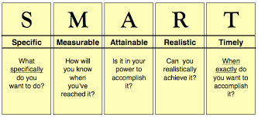
Formulating goals
“I want to identify the difference between dementia, delirium and depression, including the most common causes, symptoms and treatments. I will complete this within 8 weeks.”
Notes:
Goals are formulating SMART
Specific = What is a specific goal for my internship? A specific goals should clearly state what the student wants to accomplish, why it is an important goal and how you intend to accomplish the goal
Measurable = What are the measurable milestones you pla to reach in the process of achieving your goal? A measurable goal should include a plan with targets and milestones that the student can use to make sure he is moving in the right direction
Attainable = What are the smaller, attainable, action steps that you plan to use to achieve your goal? An achievable goal shoud be realistic and include a plan that breaks the overall goal down into smaller manageable action steps that use the time and resources available to the studentwithin the timeline the student set
Realistic = How is your goal realistic? A realistic goal should make sens when implemented into the student overall career development
Timely = What is the specific timeline for your goal? A timely goal is limited by a defined period of time ans includes a specific timeline for each step of the process

Slide 11
1. The student
During the training
Assume responsibility for his own learning proces!
Asked daily or minimum 3 times a week written feedback
Daily logbook or portfolio
A day students return from internship to school
Prepare the evaluating talk between and at the end of the training
Evaluating the goals
Strenghts and weaknesses
Self-assessment
Notes:
Feedback: before asking written feedback, student have to writte self something about his journey or experience. Than student asked written feedback to the nurse or mentor who was working with him that day. The more feedback the better, because the middle and final assessment is partially based on the written feedback.
Daily log: here students may reflect (in the beginning of the internship daily, and afterwards only when necessary) on their experiences and learning opportunities. They can reflect on their actions and knowledge. Students have to send 2 times a week their logbook to the lecturer. The lecturer read this logbook and give comments when necessary or asked questions when something isn’t clear. The lecturer can use the content of the logbook during the conversation with the student.
Refresher training: exchange of experience on the internship, organized by the school department. This moment of reflection can correct negative internship experience or can place confrontational experience. Trainees share their experiences with each other.
Self-assessment: in preparation of the interim and final evaluation, the student must score himself (in pencil) on the evaluation form. This self-assessment is used during the evaluation which always takes place with the student and the mentor. In this way it can be seen if the student over or underestimated himself and for what competences.

Slide 12
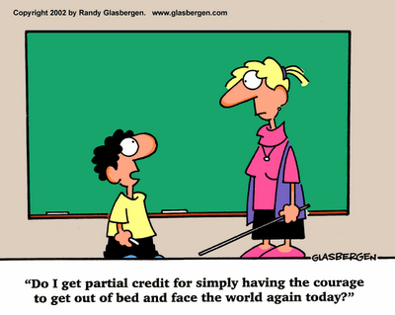
1. The student
After the training
Evaluation survey
Assigment clinical practice
Conversation afterwards with the lecturer of the school
Notes:
In some hospitals students have to fill in een digital or written evaluation survey. Just like the student is evaluated by the department, the department is evaluated by the student. In this way the nursing department can work on less good issues.
During every clinical practice students have to make an assigment, linked at the internship. Students have to bring in this assigment, normally the first day after training.
They can asked feedback to the lecturer during their internship. This assignment can be a patient discussion, a link between a scientific article and something special to the nurse ward, CAT, improvement project, …
Conversation afterwards: in this conversations the strengths and weaknesses are discussed with the student. New goals are set for the next internship. The student needs to take them to the next training period. To prevent that the student would withhold his new goals, a copy of the evaluation document is made. The student must provide the copy of his evaluation document spontaneous during the briefing with his next lecturer. if not, the lector asks himself here for.

Slide 13
2. The mentor
Acts before final assessement
Orientation for clincial practice period
Familiarizing with assessment forms
Observation of student nurses’ behaviour
Mentors’ attitudes and qualifications
Notes:
First of all: students’ degree of satisfaction during clinical placement depends on factors such as feeling welcome in the clinical placement and nurses’ attitudes regarding student supervision.
Mentors with unsupportive, indifferent (onverschillig) attitudes have a negative impact on students’ motivation to learn.
Students in clinical placement for 7 weeks or longer seem to be more satisfied than students with short placements.
Acts before final assessement
Orientation for clincial practice period (voorbereiding voor stage): the teacher, mentor and student meeting in the beginning of the clinical practice period is very important
Interview: Personal contact creates a relationship of trust. Moreover, an introduction meeting is the perfect opportunity to test the learning expectations of the trainee to the strong
points from the mentor.The trainee is never alone, even when the main mentor works at a different time than the student. Additional mentors relieve pressure on the main mentor
Familiarizing with assessment forms (kennis over evaluatieformulieren): mentor and student will know what should be assessed. The terminology on evaluation forms is sometimes so difficult to grasp, that mentors do not understand what they mean. Carefully designs evaluation forms would make the assessment more objective and clear.
Observation of student nurses’ behavior (observatie van gedragingen van de student): Overall, students are evaluated by mentors by observing, asking questions, self-assessment and written exercises. A mentor must regularly repeat what is expected of the student and use examples to do so. A mentor has to summarize, at the end of each evaluation, the strengths and concerns and ask the student whether he recognizes himself. This invites to an open discussion. Not only the mentor works with the trainee, also other nurses. A mentor has to talk regularly on the evolution of the trainee with other colleagues. In this way, the mentor will be better prepared to do an evaluation.
Mentors’ attitudes and qualifications (attitudes en kwalificaties van de mentor) The mentors do not always have enough common working time with the students during the training period, which may affect the accuracy of their evaluation. The mentor can often have too many students, or employees may change several times, so that timing of the assessment is very challenging.
Mentor education increases interest in student nurse mentoring. It is recommended to organize training sessions for mentors. These training sessions are about the curriculum, the assessment form and evaluation criteria.
Every year we organize a special training day for our mentors. Topics at the request of the mentors, are offered (again)

Slide 14
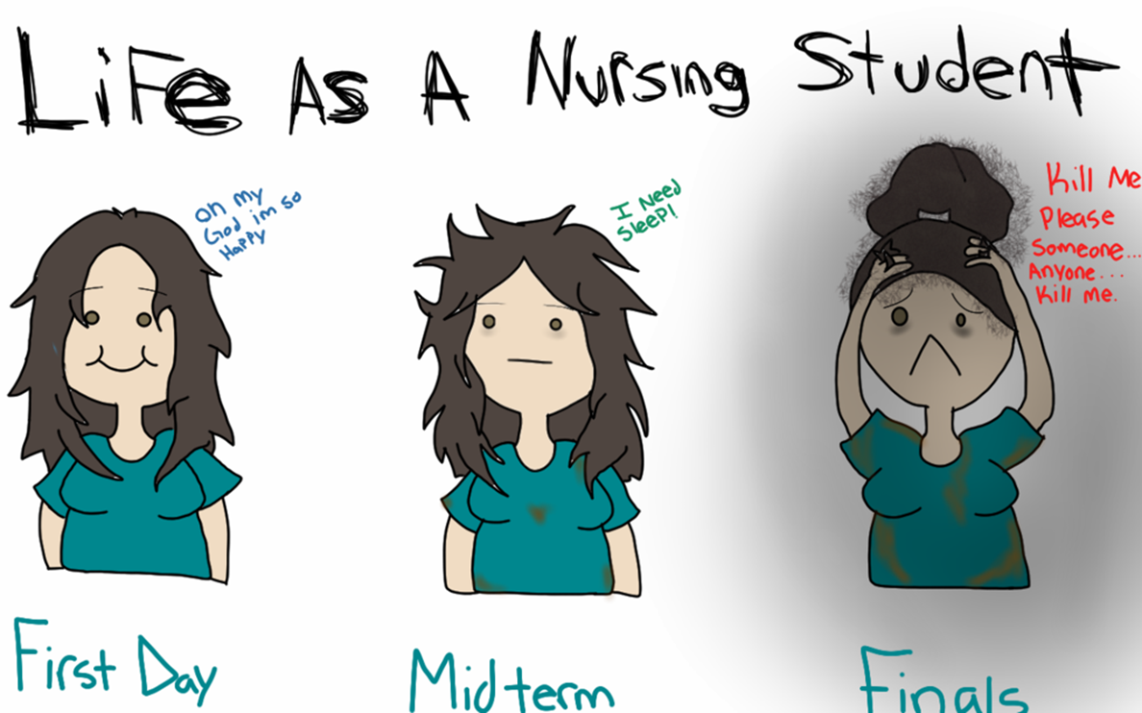
2. The mentor
The actual situation of final assessment
providing for proper assessment situation
Assuring relevant criteria for assessment
Assigning the grade
Failing students
Notes:
The actual situation of final assessment
providing for proper assessment situation (creëren van een goede evaluatieomgeving): in the final assessment situation there should ideally be a teacher, mentor and student. The final interview is meant to be a reciprocal (wederzijds) discussion which student, mentor and lecturer discuss the achieved competencies of students. The role of the lecturer is to support the mentor and the student in appropriate assessement. The students self-assess their performance, the mentor assesses by interview and written assignments whether the student has achieved the criteria.
Assuring relevant criteria for assessment (correcte en relevante evaluatiecriteria): there are different interpretations of competence assessment. Mentors can have very different criteria for the assessment and what is and is not acceptable. Students sometimes experience a difference between evidence-based teaching in schools and what mentors say is relevant to the ‘real world’. Also the personal characteristic (e.g. helpful, pleasant, self-confident) of students can considerably (aanzienlijk) influence the assessment.
Assigning the grade (toekenning van graad/score): if the lecturer and the mentor differ regarding what grade to give a student nurse, it is common for them to mutually (onderling) decid to give a lower grade. There might be inconsistencies between mentor’s feedback given to students and feedback given to the lecturer in a confidential manner. The mentor might tell the teacher that the student is not competent, but in the final assessment the mentor doesn’t mention it. Mentors want clinical practice to be a positive experience for students, which might lead mentors to give higher grades than what nurse students deserve. It is the lecturer, the university-based teacher, who has the responsibility for evaluating students.
Failing students (falende studenten): some mentors means that it is not their role to fail students, merely to give feedback. Often mentors do not have the courage to fail students who have not demonstrated sufficient competence. They found it very rare that students fail their clinical practice.

Slide 15
2. The mentor
Acts after the assessment situation
Assuring relevant documentation
Organizing extra time for failing students
Ensuring support for mentors
Notes:
Acts after the assessment situation
Assuring relevant documentation (verzekeren van correcte documentatie): clinical practice requirements should be documented and an assessment task is to ensure that a certain level is reached.
Organizing extra time for failing students (organiseren van extra tijd voor falende studenten): if the student does not achieve the clinical competencies, they are usually allowed to have extra time in clinical areas until they are assessed as competent. When students fails for an internship, they have to redo their internship next year. It isn’t possible to redo an internship in the same school year. When students are ill during a internship, they can catch up the remaining training hours during a holiday.
Ensuring support for mentors (voorzien van ondersteuning voor mentoren): mentors need support from teachers especially in assessing the student nurse’s practical skills and in written documentation. Mentors may feel they have failed in their role if the student nurse fails.

Slide 16
3. The lecturer
Notes:
The teacher’s role in the beginning of a student nurse’s clinical practice is to explain what the relevant criteria are and how to use the assessment tool. The role of the lecturer is to support the mentor and the student in appropriate assessment. An open and honest communication about the strengths and working points of the trainee is essential for its growth.
The lecturer is responsible for awarding points.
The student and the nurse ward has the contact details of the lecturer so they can always contact the lecturer with questions and concerns.

Slide 17
4. The assessment team
Notes:
After every internship all the lecturers responsible for the guidance of students during that internship are sitting together and each student is discussed. In this way we try to assign points in an objective way. To discuss the strong points and weaknessess of the students, we are able to compare students and avoid that one student gets a higher point than a similar student. When student are in special need of proper care and supervision, we make a suggestion for a future internship.
During this meeting also the care and supervision of the different places of clinical practice are discussed. Does an internship place doesn’t fulfills the learning expectations, then it is time for a meeting with the management. Goes everything wrong on an internship, year after year? Does the quality of their training do not improve after repeated consultations with the management? Dare to delete the internship, because a trainee you have to earn, doesn’t it?

Slide 18
II. Feedback
Notes:
You don’t give feedback fast-fast, but in an open discussion. Care of your posture, do not be use diminutives or 'but' and always be honest. Give the student the opportunity to ask questions.
Keep interns alert with a daily tip. So you give continuous feedback in a constructive manner

Slide 19
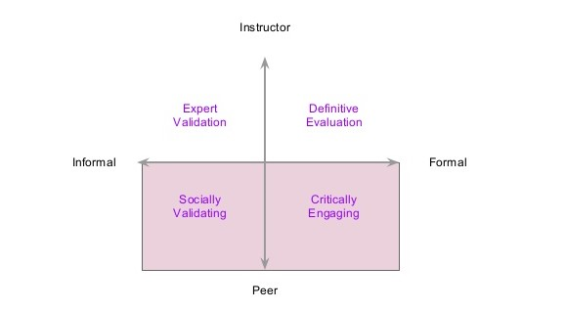
Types of feedback
Formal feedback
Informal feedback
Notes:
Feedback can be divided into two broad types, namely formal and informal feedback. With formal feedback constructive / corrective / negative feedback is provided and is given on one, moment agreed with the student. Formal feedback can be both summative and formative. Summative feedback involves a formal assessment of performance and is aimed at determining the level at which the student is working. Summative feedback through tests, reports and so on, summative feedback is more common than formative, individual feedback. Formative feedback aims to promote the learning of the student.
Most of the feedback is informal. Informal feedback is usually given without the feedback provider is aware of this and is formative in nature. It happens ad hoc and concerns feedback on a situation that has just happened. As a result, any errors can be improved immediately. A disadvantage of informal feedback may be that the student does not experience as part of the learning process and furthermore does nothing else. A combination of formal and informal feedback is the most desirable form of feedback because this information for both short (with informal feedback) and long-term is given (in formal feedback).

Slide 20
Effective feedback
Notes:
Effective feedback should contain three questions:
"Where do I need to go" (goals)
"Is there progress" (progression)
and
3. "what steps I'm going to take (activities)"?
Each question relates to four different levels:
the task level,
the process level,
the level of self-regulation and
self - level
Each feedback question works at four levels:
Process Level: The process needed to understand / perform tasks
Task Level: How well tasks are understood / performed
Self-regulation Level: Self-monitoring, directing and regulating of actions
Self Level: Personal evaluations and effect (usually positive) on the learner
Feedback aimed at the task level concerns for example feedback on a task in which told what is right or wrong has been done and where instructions are given how things should be. Feedback which are given by the feedback provider evidence that the student will continue to be able to accomplish the task feedback is aimed at the process level.
The self-regulation level feedback focused on self-reflection of the student after the student can bring about improvements in the job. The feedback giver asks for example, similarities between the current job and previous jobs and how the student has completed previous tasks.
If the feedback is focused on characteristics of the student, it governs itself level. An example is: "What you always want to know a lot!". Feedback on the level itself is the least effectieflf - level

Slide 21
How to give feedback
Notes:
Always use the sandwich method when you give feedback:
First draw attention to the strengths of the student, then extract the working points and always finish with a positive message. This method where the lesser issues brought between two positive messages is very motivating.
Prepare: Do not go into the situation without careful forethought and planning. A good outline is a tool for success. Without one, it is easy to get off track and you can lose control of the conversation. Know exactly what you're going to say and how you're going to say it.
Compliment - Identify the positive: Find something significant that the individual did. This needs to be related to the coaching you're going to give, and needs to be reasonably close in time. If, for example, all the white clothes came out of the washer pink because a red shirt was thrown in, well... "I really appreciate your helping with the laundry!"might be a way to start the conversation.
Coach - Present the facts: Now, you have their attention and they are in a receptive frame of mind. Pause just a second to let that feeling solidify, then lead directly into the coaching. Avoid using the word "but" as in "but next time" since that can create the defensive atmosphere that you're trying to avoid. Be direct and firm, but never angry and never demeaning. Communication is a science and if you want positive results, you have to be very... scientific. "I'm going to work with you on how to sort clothes so we don't end up with pink socks again.“
Encourage - Give a bright outlook: When you gave the coaching, you inevitably caused some mental deflation in the person. Do not leave that in place; it has to be removed quickly, but correctly. Project a positive outcome of future efforts. The natural conclusion is that there was a good base to start (the initial praise), there are ways to improve that base (coaching), and combining those will produce even better results. "It's great to have another set of helping hands and everybody will have more time for those after-dinner Wii battles!“
Follow Up Later: Don't wait until after the next issue arises to monitor the behavior change; be helpfully inquisitive and continue promoting change. The objective is to anchor the positive nature of the change in the mind of the individual. If you just let things drop, your coaching might be forgotten. Without consistent reinforcement, a process called "extinction" sets in: The desired behavioral change will not materialize.

Slide 22
III. Evaluation form
Notes:
Assessment must include the observable behaviours, interactions, performances and procedures demonstrated by students. It must also include decision-making processes involved in making judgements whether they are clinical or ethical as well as the underlying attitudes, cultural influences and the use of evidence. Competency based assessment is not a checklist of behaviours, it is a student centred assessment strategy designed to preveal performance, potential and evidence of attitudes, values and knowledge. The integration of knowledge, attitudes/values and skills in practice underpin competency assessment. This applies that assessment involves questioning and feedback. Good feedback is specific, immediate and balanced
Our evaluationform for internship or clinical practice is based on our competenced based curriculum. We have 14 competences. For each competence, key objectieves were prepared. On the basis of these key objectives our evaluation form is drafted.

